Slide 1
Department of Computer Science and Engineering
Second Project Progress Seminar
Session: 2025-2026 (Winter 2025)
Group Number: - CSE_C_06
Date : 30-sept-2025
Title of the Project:-FlowCall : AI That Talks Business
Presented By:
Rasika Borade (B_18)
Tanishka Borade (C_14)
Punyaa Dixit (C_05)
Kanchan Sharma (B_13)
Guide
Prof. Sonali Bhardwaj
Assistant Professor
GHRCE , Nagpur

Slide 2
Project Description
Objective: The project aims to build FlowCall, a SaaS platform that creates customized AI-powered voice assistants tailored to different industries, ensuring faster deployment, seamless integration, and cost-effective automation of customer support
Scope : The platform is designed for multiple industries like hospitality, education, healthcare, retail, and professional services, with the ability to integrate booking, CRM, and payment systems, deploy within days, and scale to handle hundreds of simultaneous conversations
Benefits: FlowCall delivers cost savings up to 76%, a break-even in just 2–3 months, 24/7 availability, faster query resolution, and improved customer satisfaction, making it an efficient and economically viable solution for businesses of all sizes

Slide 3
Research Gap
Most AI voice assistants available today are generic and not fully adapted to the needs of different industries.
They do not support all languages, which reduces their usability in global or multilingual environments.
Even with automation, it still takes about a week to set up and deliver the final solution to customers.
There is a lack of platforms that can provide instant deployment instead of long setup times.
Existing research focuses mainly on single-industry solutions, not multi-industry platforms like healthcare, hospitality, and education together.

Slide 4
Introduction
In today’s fast-paced academic environment, students often face delays in getting their queries resolved.
Our project introduces an AI-powered voice assistant and chatbot to provide instant, human-like support.
It integrates Make.com for automation and Vapi.ai for voice calling, ensuring smooth query handling.
The system offers 24/7 assistance, reduces staff workload, and improves student satisfaction.
Future-ready with features like emotion recognition, and voice verification.

Slide 5
Research Gap
Limited human-like conversation: Existing voice assistants struggle with context-aware, multi-turn interactions.
Poor integration with business tools: Minimal connectivity with CRM, ticketing systems, and workflow platforms.
Lack of multilingual and emotion recognition capabilities: Inability to adapt to diverse languages and detect customer emotions.
High cost and low scalability: Traditional call center and IVR solutions remain expensive and resource-heavy.
Low personalization: Customer interactions often feel robotic and generic rather than tailored.

Slide 6
Abstract
In today’s academic environment we often face delays in resolving our queries due to limited staff and traditional communication channels. To address this challenge, our project introduces an AI-powered voice assistant and chatbot capable of interacting in a natural, human-like manner, understanding our needs, and automating routine tasks. This ensures quick responses, round-the-clock availability, and reduced workload for support staff.
The system integrates Vapi.ai for real-time voice capture and speech recognition, Ollama LLM for intent detection . It can handle multilingual inputs, provide instant responses, and connect with academic or business applications for smarter workflow management.
Unlike traditional call center solutions that are costly, limited in personalization, and lack multilingual or emotional intelligence, our system is scalable, cost-effective, and future-ready. With potential enhancements such as emotion recognition, voice-based authentication, and deeper integrations, it aims to deliver a smarter and more satisfying student support experience.

Slide 7
Hardware / Software Specification
SOFTWARE | HARDWARE
Vapi AI – Voice conversation engine | Laptop/Desktop – Development (4 GB+ RAM)
Make.com – Workflow automation | Internet Connectivity – For APIs & services
Ollama – Large Language model | Mobile Phone – For testing AI calls
OpenAI / Azure – Communications
MongoDB / Firebase / SharePoint – Database storage
JWT / Firebase Auth – Authentication
Axios / Postman – API communication/testing
Chart.js / Google Sheets – Call analytics (optional)
Twilio – Phone Number

Slide 8

Literature Survey
Sr. | Title of the paper | Year | Algorithm/ technique/ tools used | Accuracy/ Result Achieved | Remarks | Shortcoming/Advantages | Link
1. | Advanced Real‑Time Fraud Detection Using RAG‑Based LLMs | 2025 | RAG (Retrieval-Augmented Generation), LLM | ~98% fraud detection accuracy | Detects fraud in real-time calls using grounded LLM responses | Needs good corpus High precision | https://arxiv.org/abs/2501.15290
2. | Auto Review: Second Stage Error Detection for Phone Conversations | 2025 | ASR alternatives, pseudo-labeling, 2-stage NLP | Significant error reduction | Improves phone transcription accuracy via layered review | ASR-dependent Less manual review | https://arxiv.org/abs/2506.05400
3. | Generative Voice Bursts during Phone Call | 2025 | LLMs for contextual voice injection | N/A (qualitative insights) | lVoice alerts injected live during calls | No benchmarks Novel idea | https://arxiv.org/abs/2506.07526
4. | iLLM‑Powered GUI Agents in Phone Automation: A Survey | 2024 | IMulti-agent LLM frameworks | N/A (survey paper) | Reviews LLM agent architecture for call flows | No test data Great overview | https://arxiv.org/abs/2504.19838

Slide 9
Literature Survey
Sr | Title of the paper | Year | Algorithm/ technique/ tools used | Accuracy/ Result Achieved | Remarks | Shortcoming/Advantages | Link
5. | Voice-Based AI in Call Center Customer Service: A Natural Field Experiment | 2024 | Voice AI vs Human (A/B test) | ~12% efficiency + CSAT boost | Real-world service experiment | Limited sample Real deployment | wiley.com/doi/abs/10.1111/poms.13953
6. | AI-Based Call Center Management | 2024 | IVR, facial recognition, dashboards | N/A (design blueprint) | Backend + workforce AI design | Not tested Holistic plan | journals.orclever.com/ejrnd/article/download/593/340/1406
7. | A Review of NLP in Contact Centre Automation | 2023 | NLP for routing, summarization | Varies per task | Comprehensive NLP survey for contact centers | No new method Solid foundation | link.springer.com/article/10.1007/s10044-023-01182-8
8. | IVR Systems in Call Center Management – Scientometric Analysis | 2023 | IVR, ASR, mapping tools | N/A (trend-focused) | Tracks global research direction | Meta-only Research map | frontiersin.org/articles/10.3389/fcomp.2025.1459787/full

Slide 10
Methodology
Voice Input: The user simply talks through a phone call or browser. Their voice is captured using Vapi.ai or Exotel in real time.
Speech Recognition & Language Detection: The system turns the voice into text instantly. It also figures out which language the user is speaking.
Translation (if needed): If the user spoke in a regional language, it’s translated to English. This helps the system understand everything better.
Intent Detection: The AI (Ollama LLM) reads the message and understands the request. It knows whether the user wants to book, or ask something.
Response Translation + TTS: The reply is translated back to the user's language if needed. Then, it's spoken out loud using a natural voice assistant.
Task Execution: Behind the scenes, it carries out tasks like bookings or CRM updates. This is handled through Microsoft Power Automate.
Data Logging: Everything is saved securely — voice, intent, and details. Stored in Microsoft Dataverse to keep records and improve service.

Slide 11
Module Description
Process in Make.com • Validate Info
• Format for Vapi API
• Store in Database
Enter Student Info
(Name, Contact, Issue)
Trigger Make.com
(Automation starts)
Start
Escalation Triggered via Make.com
• Notify Support Staff
• Slack/Email/CRM Update
• Assign Human Agent
Did the Student Issue get resolved?
Yes
Vapi Calls Student
(Automated Voice Call)
No
Manual Resolution
• Staff follow-up
• Final Outcome Stored
Mark as Resolved
• Update DB
• Send Report
End

Slide 12
Module Description
Module | Functionality | Tools/Libraries
Voice Call Handling | Receives customer voice calls via browser or phone Securely streams audio for processing | Vapi.ai
Speech-to-Text (STT) | Converts spoken audio to text Uses multilingual STT engines | Google STT, Azure STT,Ollama
Language Detection & Translation | Detects spoken language in real-time Translates text to/from English for processing Translates responses back if needed | Google Cloud Translation API Microsoft Azure Translator Amazon Translate
Intent Recognition (LLM) | Understands user intent via Ollama LLM Generates smart AI responses | Ollama LLM
Text-to-Speech (TTS) | Converts AI responses to speech Outputs in the user's original language | Azure TTS, Google TTS

Slide 13
Module Description
Module | Functionality | Tools/Libraries
Automation Trigger | Executes backend workflows Examples: Booking, logging complaints, CRM updates | Microsoft Power Automate
Call Logging & Data Storage | Stores transcripts, intents, timestamps, insights Secures storage of call data and metadata | Microsoft Dataverse
Security & Compliance | Ensures secure data handling Secure API communication Encrypted storage Compliance with telecom regulations | Protocol standards, Encryption methods

Slide 14
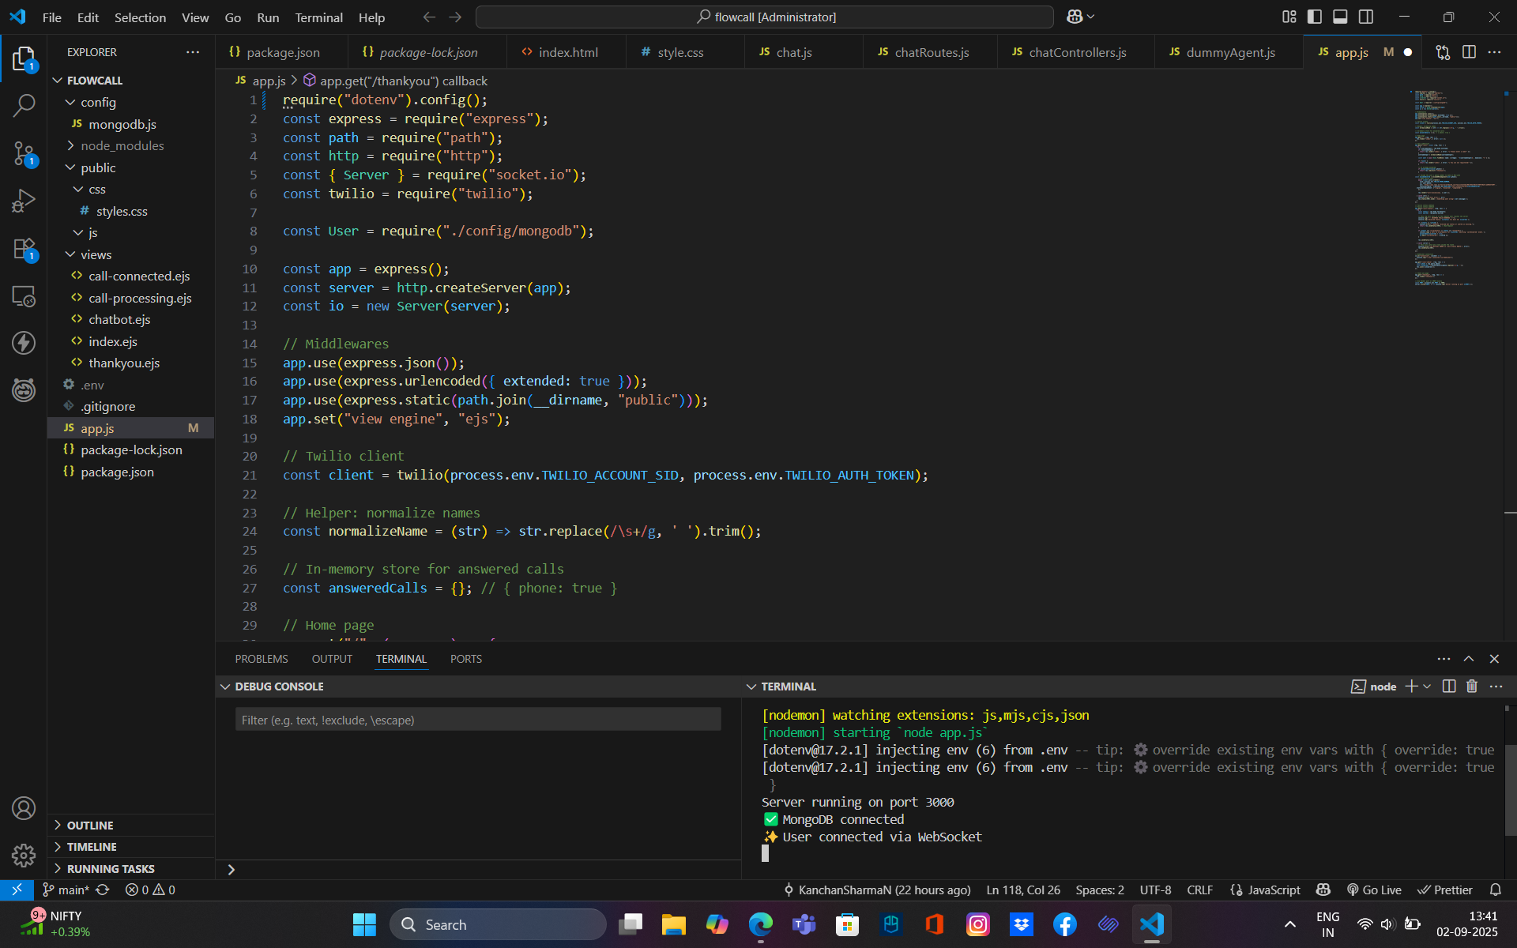
Project Screenshots
Fig Call Interface Logic

Slide 15
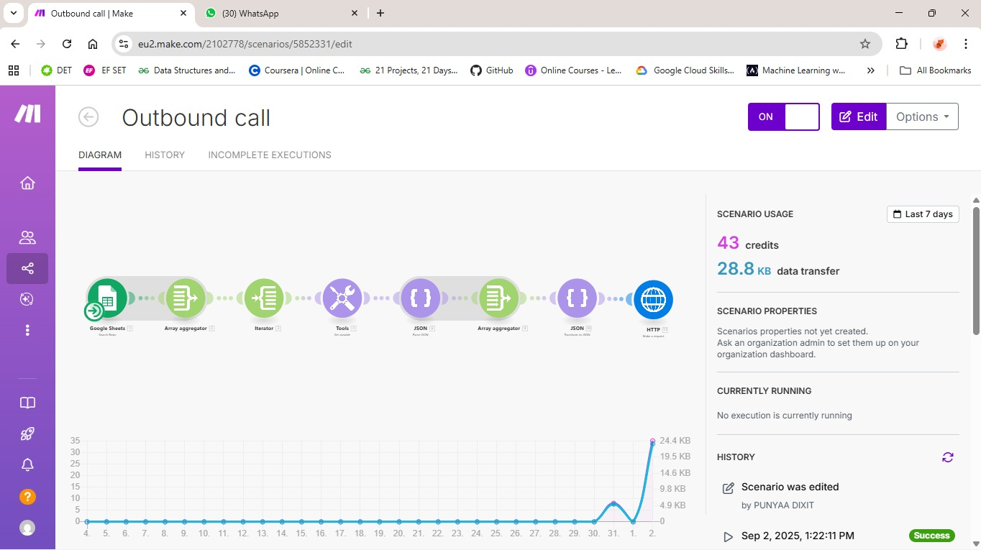
Project Screenshots
Fig . Call Interface Logic

Slide 16
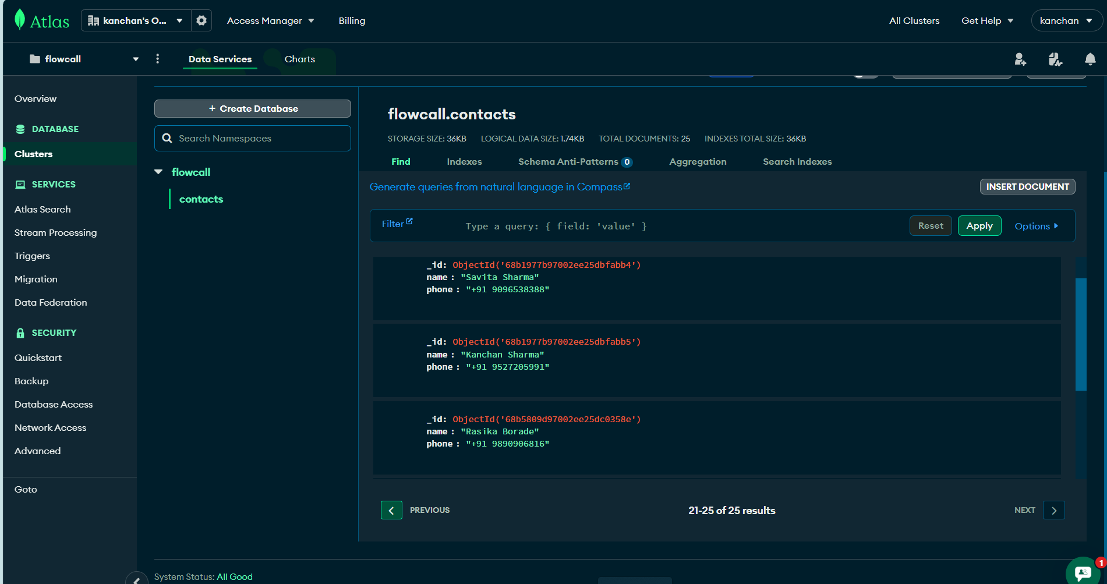
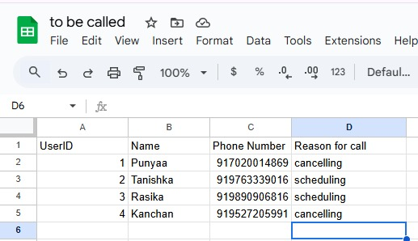
Project Screenshots
Fig 5. MongoDB (backend demonstration)

Slide 17
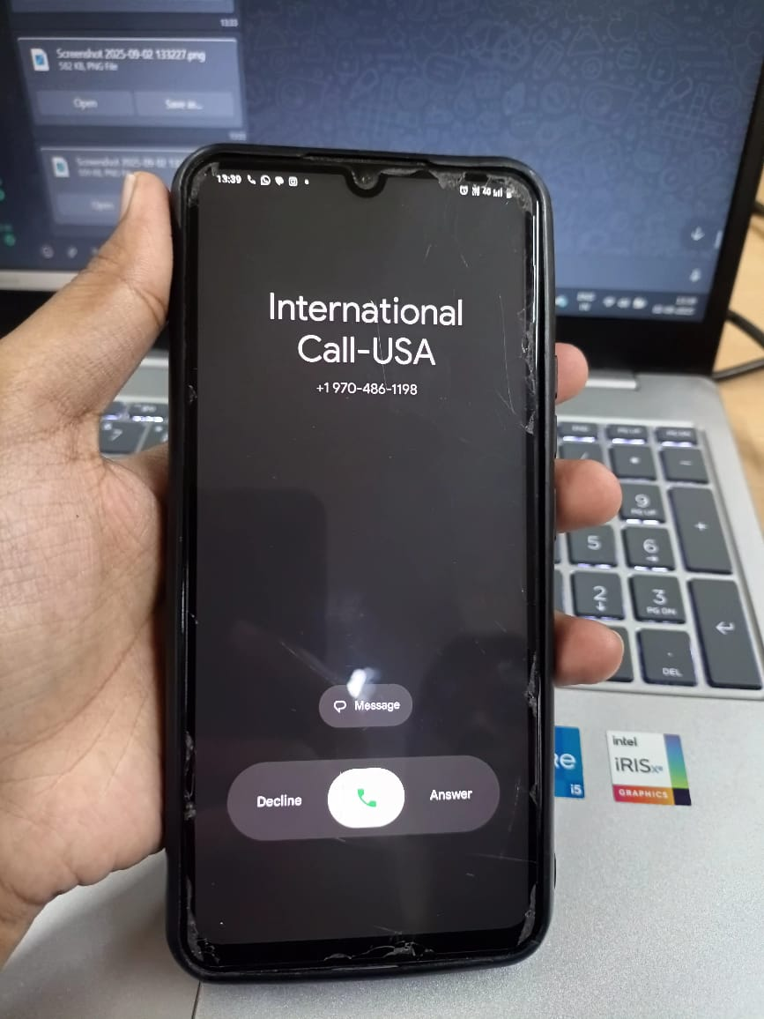
Project Screenshots
Fig AI assisted Call Preview

Slide 18
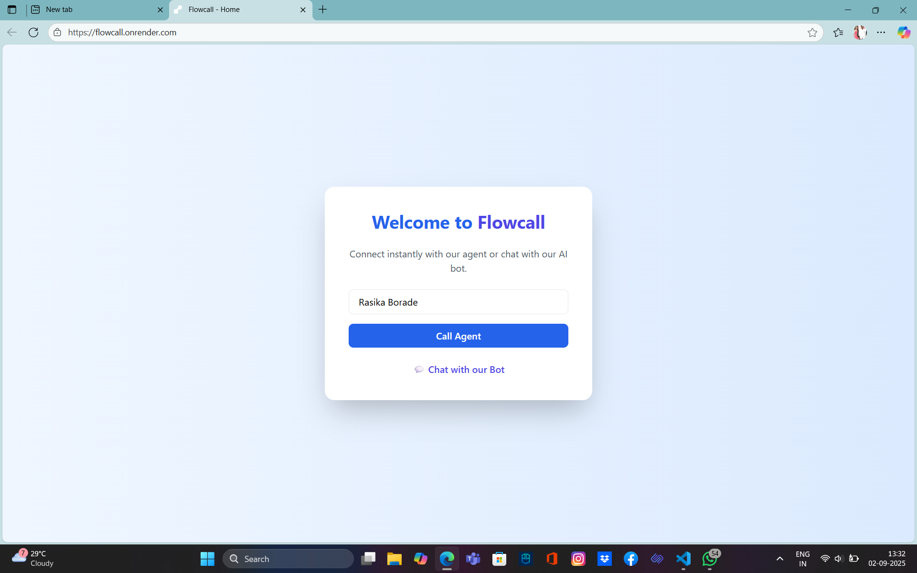
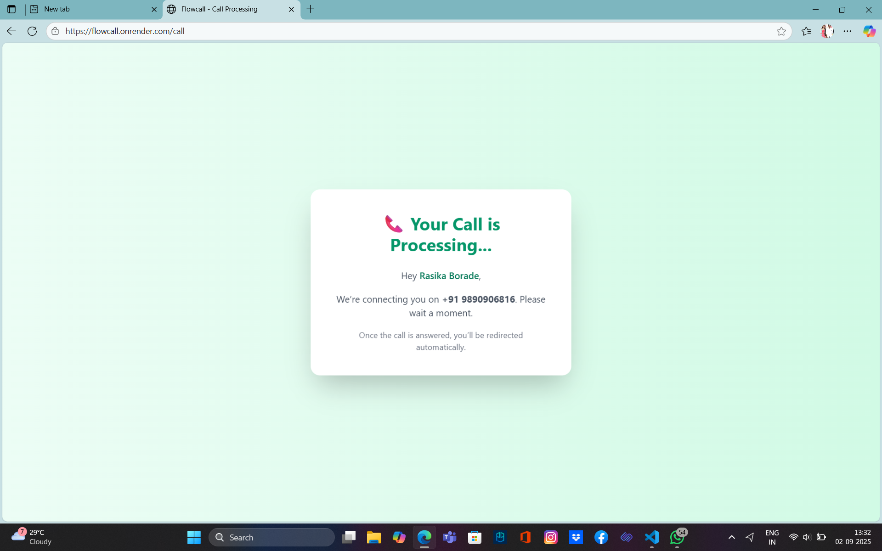
Project Screenshots
https://flowcall.onrender.com/
Fig Sign in page and Call Processing

Slide 19
Conclusion
The project demonstrates that an AI-powered voice assistant with chatbot integration can provide quick, human-like query resolution for students.
By combining Vapi for real-time voice capture, Twilio for communication, and Make.com for automation, the system ensures smooth query handling with minimal manual intervention.
The solution offers 24/7 availability, thereby reducing dependency on staff and ensuring timely student support.
It is scalable, cost-efficient, and future-ready, unlike traditional call center models that require continuous manpower.
With potential enhancements such as multilingual support, emotion recognition, and voice authentication, the assistant can evolve into a comprehensive digital helpdesk for the college.

Slide 20
Conclusion
Economic Feasibility
Traditional Call Center Cost:
3 support staff required to handle student queries.
Avg. salary: ₹20,000/month per staff.
Annual cost = ₹7,20,000.
Proposed AI Assistant Cost:
Vapi.ai: ~₹3,000/month (voice AI & speech processing).
Twilio: ~₹3,500/month (calls & SMS integration).
Make.com: ~₹2,000/month (workflow automation).
Total Monthly Cost = ~₹8,500
Annual Cost = ~₹1,02,000
Net Savings:
Traditional Call Center: ~₹7,20,000/year
Proposed AI Assistant: ~₹1,02,000/year
Savings = ~₹6,18,000/year (~86% cost reduction)

Slide 21
References
[1] G. Singh, P. Singh, and M. Singh, “Advanced Real‑Time Fraud Detection Using RAG‑Based LLMs,” *arXiv preprint arXiv:2501.15290*, 25 Jan. 2025.
[2] A. Qamar, A. Raghuvanshi, C. Sathi, and Y. Son, “Auto Review: Second Stage Error Detection for Highly Accurate Information Extraction from Phone Conversations,” *arXiv preprint arXiv:2506.05400*, Jun. 2025.
[3] P. Ranjan, S. Majumder, and P. Roy, “Generative Voice Bursts during Phone Call,” *arXiv preprint arXiv:2506.07526*, 9 Jun. 2025.
[4] G. Liu, P. Zhao, L. Liu, Y. Guo, H. Xiao, W. Lin, Y. Chai *et al*., “LLM‑Powered GUI Agents in Phone Automation: Surveying Progress and Prospects,” *arXiv preprint arXiv:2504.19838*, Apr. 2025.
[5] L. Wang, N. Huang, Y. Hong, L. Liu, X. Guo, and G. Chen, “Voice-based AI in call center customer service: A natural field experiment,” *Production and Operations Management*, vol. 32, no. 4, pp. 1002–1018, Apr. 2023, doi: 10.1111/poms.13953. :contentReference[oaicite:1]{index=1}
[6] S. Shah, H. Ghomeshi, E. Vakaj, E. Cooper, and S. Fouad, “A review of natural language processing in contact centre automation,” *Pattern Analysis and Applications*, vol. 26, no. 3, pp. 823–846, Jun. 2023, doi: 10.1007/s10044-023-01182-8. :contentReference[oaicite:2]{index=2}
[7] E. Coman, “IVR systems used in call center management: a scientometric analysis of the literature,” *Frontiers in Computer Science*, vol. 7, Apr. 2025, Art. no. 1459787, doi: 10.3389/fcomp.2025.1459787. contentReference[oaicite:3]{index=3}

Slide 22

Thank You!

